Slide 1

Programming
& Languages

Slide 2

What is coding?
Scott Said
Code is a set of step by step instructions that a computer uses to complete a task
While you are coding you need to write in a specific language that the computer will read.
You also need to remember that a computer only does what you tell it to, and depending on how efficiently your code is.. Is how the computer will run the code (fast, slow or efficient i.e.)

Slide 3

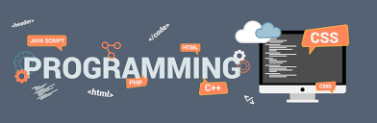
What is coding?
Programming?
Programming is the process of writing computer programs to make a computer perform certain tasks.
An early proposal for a high-level programming language was Plankalkül, developed by Konrad Zuse for his Z1 computer between 1943 and 1945 but not implemented at the time. The first functioning programming languages designed to communicate instructions to a computer were written in the early 1950s.
Computer programming is the process of designing and building an executable computer program.
Ada Lovelace, a mathematician, is commonly called the first computer programmer after creating a machine algorithm for Charles Babbage’s general purpose computer “The Analytical Engine”
Courtney Pearce

Slide 4
What is coding?
Confusion ?
Programming Language
C
C++
C#
Java
Scripting Language
JavaScript
Php
Perl
VBScript
Markup Language
HTML
XML
XHTML
Dafydd Graves

Slide 5




Steps of programming
SOLUTION
STRUCTURE
BUILD

Slide 6
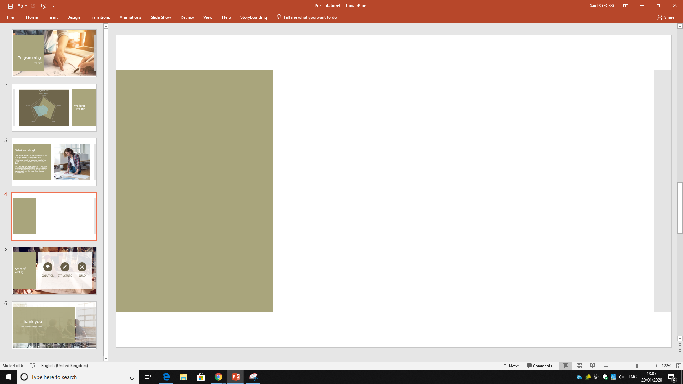
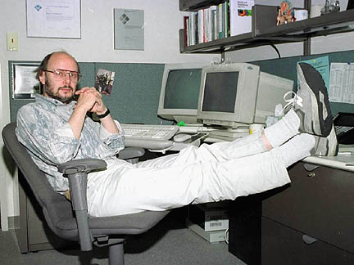
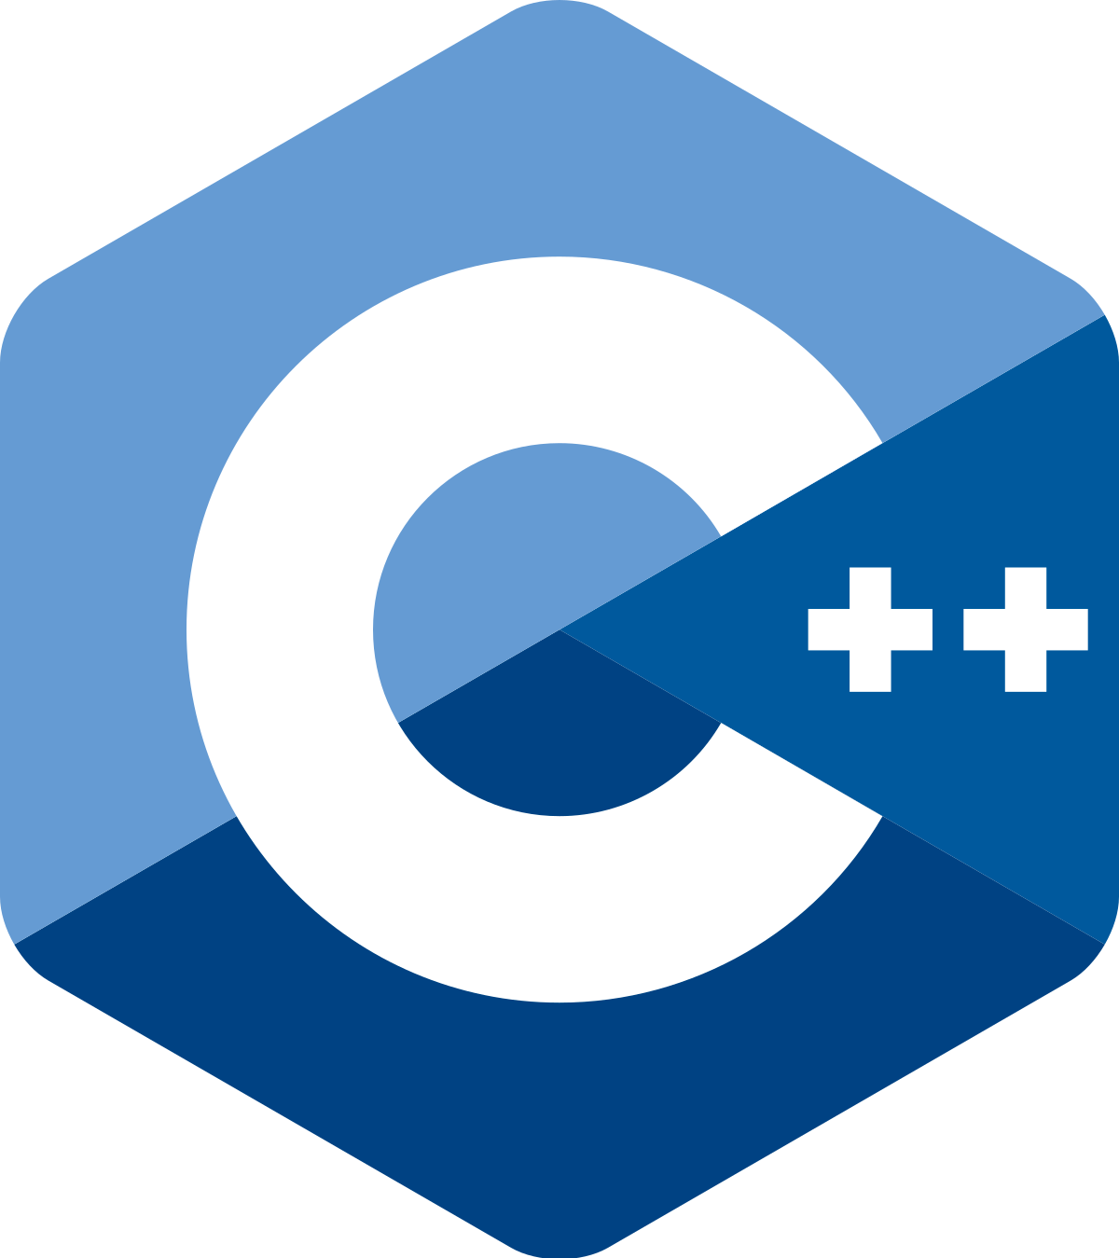
What is coding?
C++
*Here*
Bjarne Stroustrup created and developed c++
Development started in 1982
C++ was created from a modification of the C programming language called ‘C with classes’
standardised in 1997

Slide 7
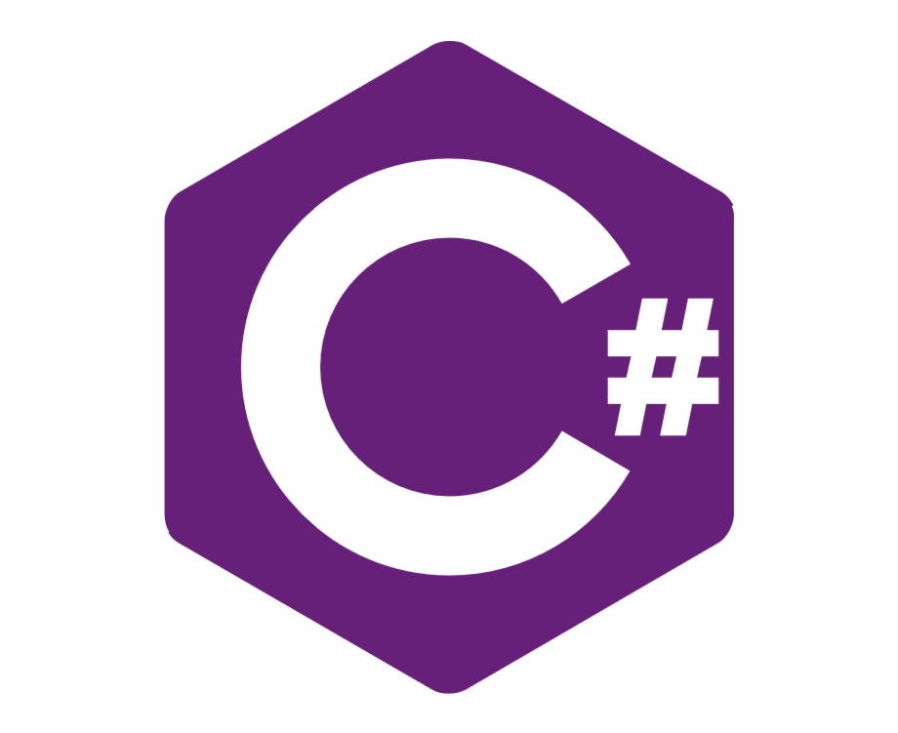

What is coding?
C#
C# is a modern object-oriented programming language which was developed in 2000 by Anders Hejlsberg
*Here*

Slide 8
What is coding?
Peng Zhang
C#
C++
C++ compiles into machine code
C++ requires you to handle memory manually
C++ can use pointers anywhere.
C++ can be used on any platform
C++ can create stand-alone and console applications. C# can create a console, Windows, ASP.NET, and mobile applications, but cannot create stand-alone apps.
C# compiles to CLR, which is interpreted by ASP.NET
C# runs in a virtual machine which can automatically handle memory management
c# does bit use pointers
C# is standardized but is rarely used outside of Windows environments.
C# can create a console, Windows, ASP.NET, and mobile applications, but cannot create stand-alone apps.
*Explain what programming is and where it came from*

Slide 9

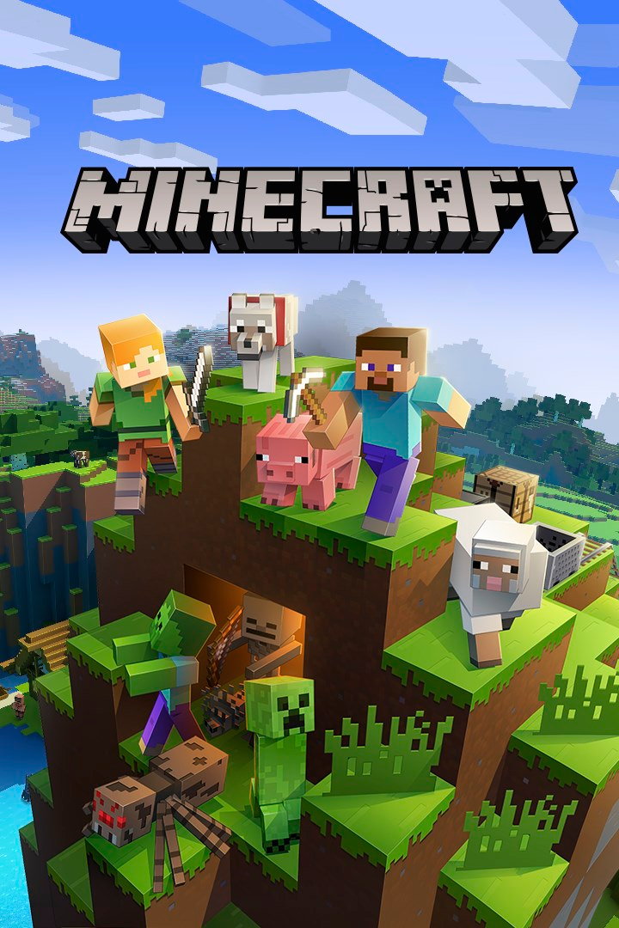

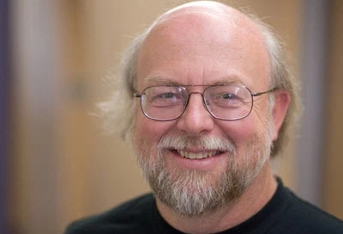
Java
Callum Evans
Java began development in 1991 and was then released in 1995 by James Gosling.
Developed by Sun Microsystems
Java was originally called Oak but it had to be changed because ‘oak’ was already registered for another computer company

Slide 10


Python
What is coding?
*Here*
Created by Guido Van Rossum
First appeared in 1990
Python has slowly grown to be one of the most popular programming languages
Has easier code readability and allows programmers to use less code.
Python supports all the major platforms
Python is a good language for GUI development
Dafydd Graves

Slide 11


PHP
What is coding?
callum evans
*Here*
PHP was created by Rasmus Lerdorf
First appeared in 1995
PHP has a low learning curve
PHP is a scripting language

Slide 12
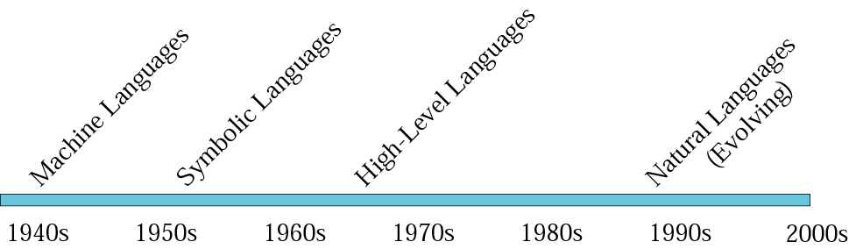
Evolution of computer languages

Slide 13


Ruby
What is coding?
*Here*
Ruby is a scripting language
Appeared around 1995
Created by Yukihiro Matsumoto
Ruby was named after a birthstone of one of the creators colleagues
Designed simple like a Lisp language
Very similar to Python
Dafydd Graves

Slide 14

What is coding?
Program Text Editors
Word processors format the appearance of the text
Text editors
Format the spacing between words for legibility
Ideal for structured languages
Text is the same font size
Examples
DOS – Edit
Windows – Notepad, Wordpad
Unix / Linux – ed, vi, emacs
IDEs
MS Visual C++, Symantec Visual Cafe

Slide 15

Compiler
What is a compiler?
A compiler is a computer program that translates computer code written in one programming language (the source language) into another language

Slide 16
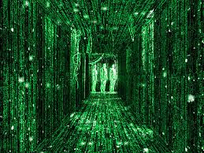
What is coding?
Structured Query Language
database
management language for relational databases
Programming Language Categories
Machine Language
Binary coded instructions
Assembly Language
Symbolic coded instructions
Procedural Languages
procedural statements or arithmetic notation
Four-generation Languages
Natural language and nonprocedural statements
Object-oriented Languages
Combination of objects and procedures

Slide 17


Thank you...
Now let the games begin
https://www.mentimeter.com/s/17e60c05f3222714a3ec1e522cc00423/6947ced701c7/edit

